Slide 1
GAMES PLAYING USING REINFORCEMENT LEARNING
Under the Guidance of,
Mr.P.DURGA PRASAD
Submitted By,
CH.VAMSHI(4511-18-733-017)

Slide 2
CONTENTS
1. ABSTRACT
2. INTRODUCTION
3. EXISTING SYSTEM & DISADVANATGES
4. PROPOSED SYSTEM & ADVANTAGES
5. ARCHITECTURE / BLOCK DIAGRAM
6. SYSTEM REQUIREMENT SPECIFICATION
7.MODULES & THEIR DISCRIPTION
8.UML DIAGRAMS
9. OUTPUT SCREENS
10. CONCLUSION
11. FUTURE ENHANCEMENT
12. REFERENCES & BIBLOGRAPHY

Slide 3
ABSTRACT
Reinforcement learning is a self-learning algorithm in which an agent acquires experience through continuous interaction with the environment, learn from the observations and rewards.
We dive into Deep Reinforcement Learning to train the agents to play more complicated games very easy and with high performance when compared human performance.
Using Reinforcement Learning in the past years developed like Alpha Go and Chess they can beat World champions.

Slide 4
INTRODUCTION
Generally we are Playing Games for Entertainments, If we are playing any game at certain point we definitely loose that game.
In the Place human We Replace with develop an AI agent, that is able to learn how to play the popular game with High accuracy.
To do it, we implement Reinforcement Learning Algorithms using like Keras on top of Tensorflow and PyTorch.

Slide 5
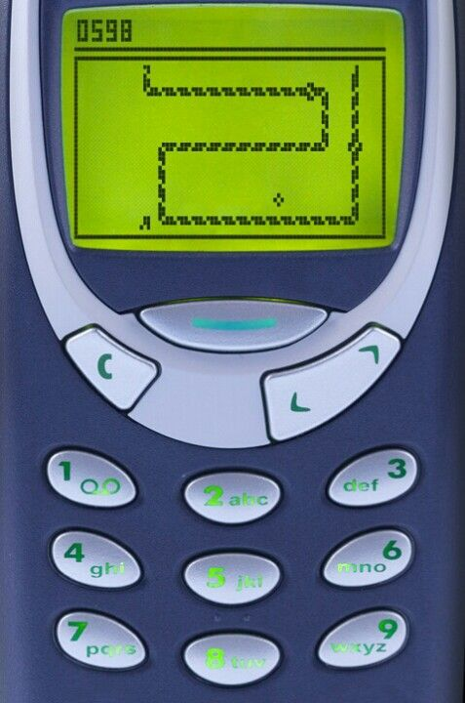
EXISTING SYSTEM
Non Machine Learning Techniques:
This are mostly Based on the Graph Theory ,Using Cyclic Paths, Hamilton Cycle.
Genetic Algorithms:
This approach is modeled less of biological evolution and natural selection.

Slide 6
DISADVANTAGES
Non Machine Learning Techniques ,does not any standard algorithm.
And also Very slow for Larger game boards.
Genetic Algorithms not always produce a good Performance.

Slide 7
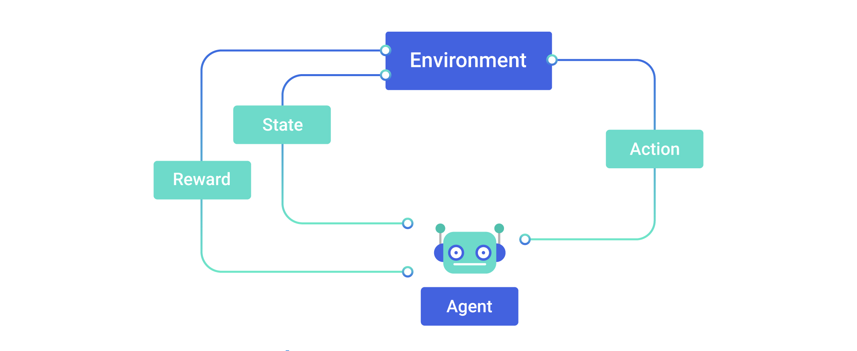
PROPOSED SYSTEM
REINFORCEMENT LEARNING:
Reinforcement Learning is one of the type of Machine Learning, When an agent can be sequentially interacting with environment, in that process the agent can learn from the environments by using observations, and rewards.

Slide 8
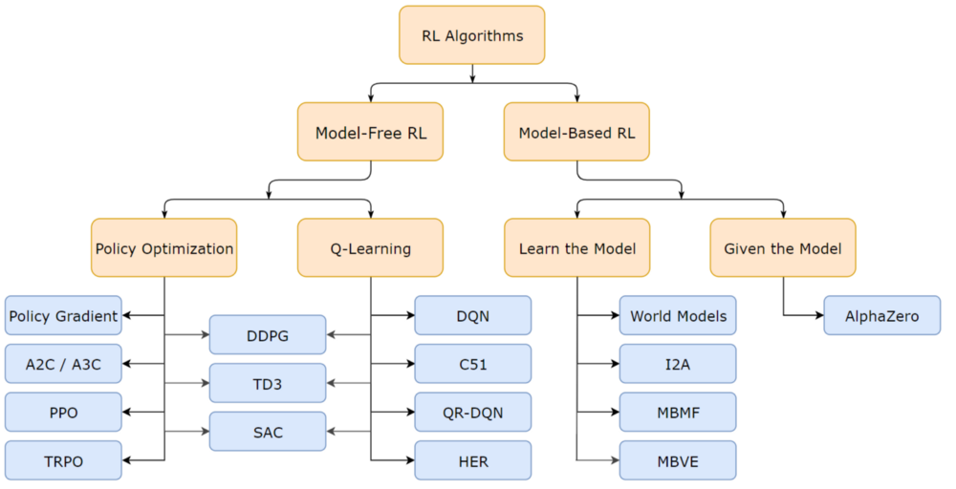
Types of Reinforcement Learning

Slide 9
ADVANTAGES
Using reinforcement learning, we can improve and personalize the gaming experience in real-time.
It is the algorithm that can solve different games and sometimes achieve super-human performance.
This gaming technology is base for the learning of robots.

Slide 10
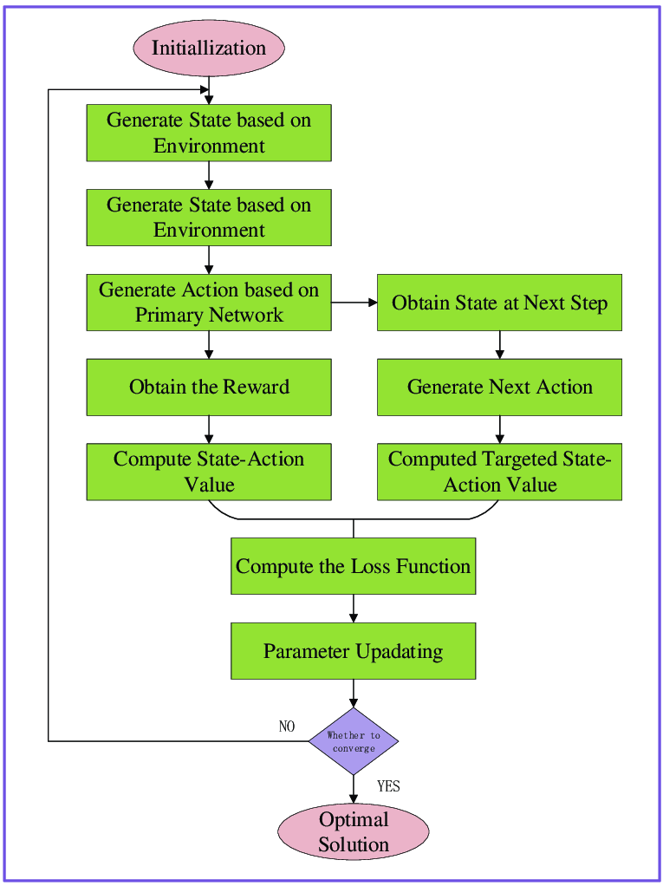
BLOCK DIAGRAM

Slide 11
SYSTEM REQUIRMENTS
OPERATING SYSTEM: windows 11
CODING LANGUAGE: Python(3.0)
DOMAIN: Machine learning
HARDWARE REQUIREMENTS
PROCESSOR:2.70GHz
RAM :4 GB
HARD DISK:320 GB

Slide 12
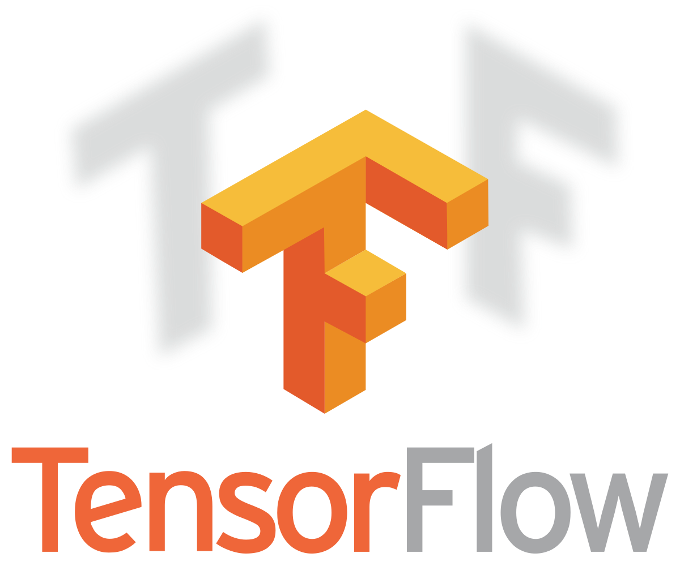

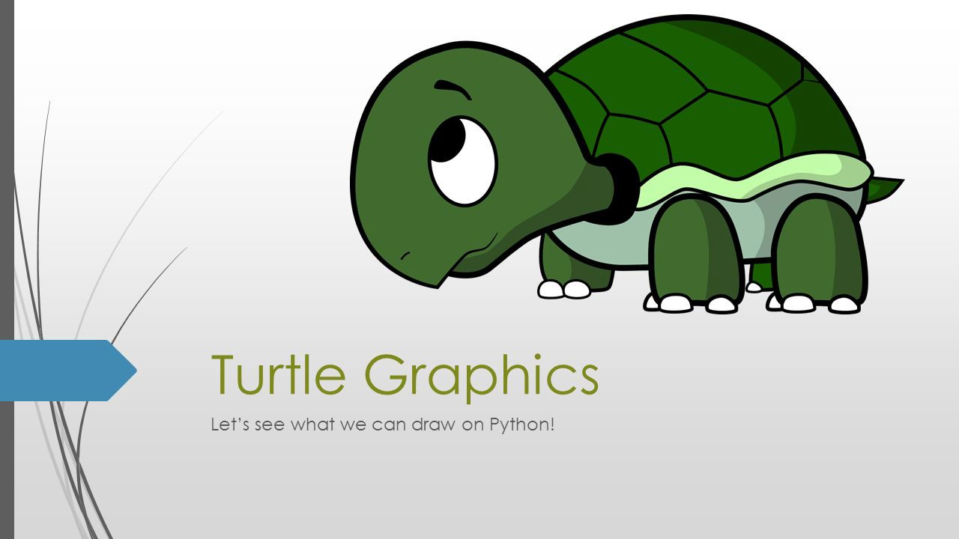
MODULES & DESCRIPTION
Creating Custom Environment.
Playing with State space.
Experience Replay.
Deep Q Neural network.
Results

Slide 13


Markov Decision Process Components:
Agent:
The Agent is an intelligent thing.
State:
The Location at which a agent is present at a particular instance is called its state.
Ex: In snake game, at point (20,20).
Action:
Actions are nothing but the moves made by the agent to any location.
Ex: In snake game , Left, Right, Up, Down.
Reward:
There are Two Types of rewards,
Positive Reward:
If the Agent can succeed to reach the goal it gives + reward.
Negative Reward:
If the Agent can not succeed to reach the goal it gives – reward.

Slide 14
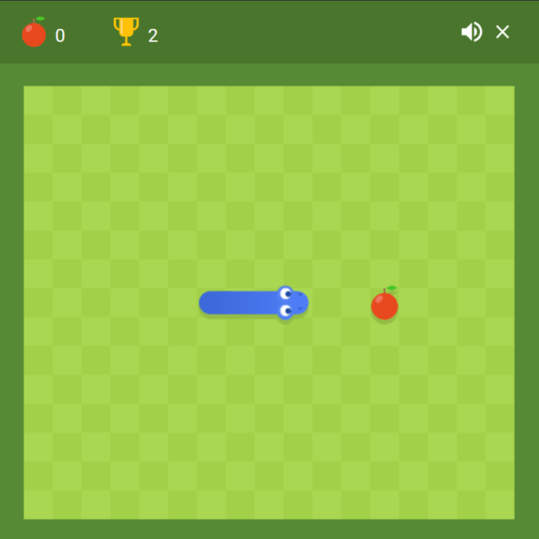
Creating Custom Environment
Environment:
Environment is the Agent's world in which it lives and interacts.
Ex: snake game environment.

Slide 15
By adding Some more methods to existed game program then we can create Reinforcement Environment.
The Methods are:
1.reset()
2.step()
3.get state()

Slide 16
Playing with State Space
The agent learns to play agent (with experience replay), but maybe it’s possible to change the state space and achieve similar or better performance.
State space ‘no direction’: don’t give the agent the direction is going.
State space ‘coordinates’: replace the location of the target. The coordinates are scaled between 0 and 1.
State space ‘direction 0 or 1’: the original state space.
State space : don’t tell the agent when the body is up, right, down or left, only tell it if there’s a dangerous.

Slide 17
Experience Replay
One secret behind fast learning of the agent is experience replay.
In experience replay the agent stores previous experiences and uses these experiences to learn faster.
At every normal step, a number of replay steps is performed.
This works so well for Agent because given the same state action pair, there is low variance in reward and next state.

Slide 18
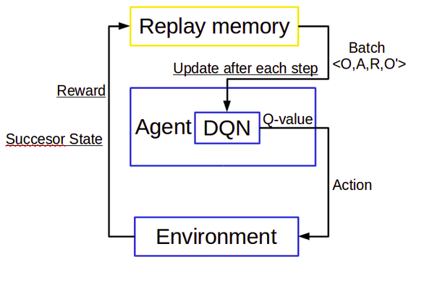

Slide 19
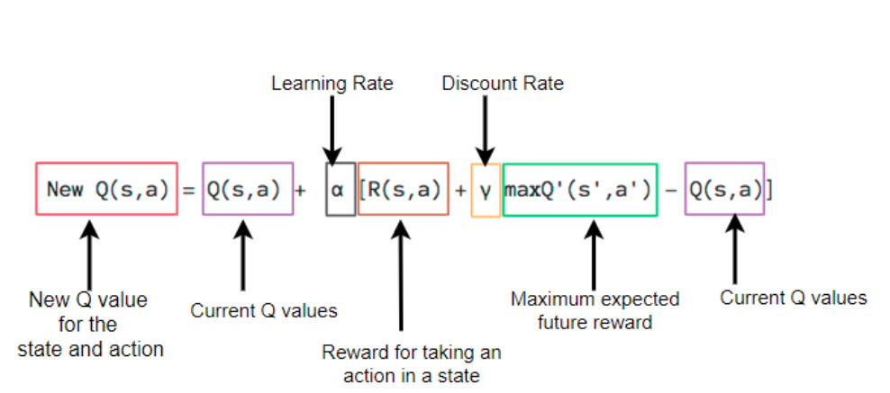
Bellaman Equation:

Slide 22
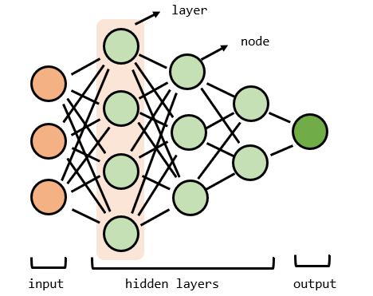
Deep Q Network
artificial neural networks to map inputs to outputs , because it can approximate any function with using hidden layer.
The network exists of layers with nodes, The first layer is the input layer. Then the hidden layers transform the data with weights and activation functions.
The last layer is the output layer, where the target is predicted. By adjusting the weights the network can learn patterns and improve its predictions.

Slide 24
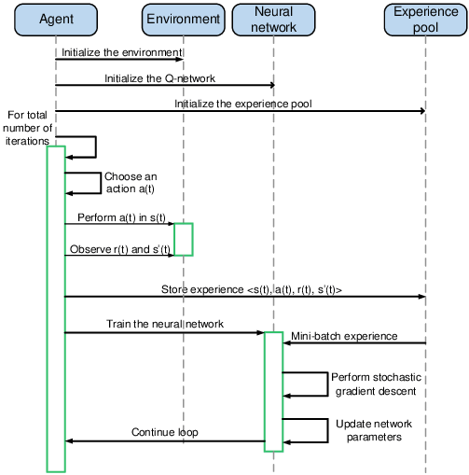
UML DIAGRAMS

Slide 25
OUTPUT SCREEN

Slide 26
CONCLUSION
This example shows how a simple agent can learn the mechanism of a process.
In this phase, the agent is often taking random actions to explore the board and store in its memory many different states, actions, and rewards.
During the last some games, the agent is not taking random actions anymore, but it only chooses what to do based on its neural network (its policy).

Slide 27
FUTURE ENHANCEMENT
Playing of Games with Multi agent Based type.
Developing Virtual Environment Based games.
The Agent can give instructions to human For Better Accuracy to play games.

Slide 28
REFERENCES & BIBLOGRAPHY
1.https://towardsdatascience.com/introduction-to-various- reinforcement-learning-algorithms-i-q-learning-sarsa-dqn-ddpg- 72a5e0cb6287.
2.https://towardsdatascience.com/how-to-teach-an-ai-to-play-games-deep-reinforcement- learning.
3. https://hackernoon.com/choosing-the- right-machine-learning-algorithm-68126944ce1f.
4.https://www.kaggle.com/learn/intro-to-game-ai-and-reinforcement-learning.

Slide 29
THANK YOU

